Slide 1
ECOMERCE WEBSITE
Submitted in the partial fulfillment for the award of the degree of
BACHELOR OF ENGINEERING
IN
BIG DATA ANALYTICS
Submitted by:
AYUSH SURYAWANSHI 20BCS4424
AMARPREET SINGH 20BCS4438
OMKAR DHISHAN 20BCS4425
SAGAR GROVER 20BCS3802
ADITYA ARORA 20BCS3758
Under the Supervision of:
MRS. PUNEET KAUR MAM
Department of AIT-CSE
DISCOVER . LEARN . EMPOWER

Slide 2
Outline
Aim of the Project
Problem Formulation
Objectives of the work
Methodology used
Results and Outputs
Conclusion
Future Scope
References

Slide 3
Aim of the project
Our project aim is to create a ecommerce website using the front end techniques (mainly html,css,javascript etc). Using this website the user can buy costumes, cosmetics etc.
We have done our backend with php using xamp server and databases.

Slide 4
What is E-Commerce?
E-Commerce commonly known as Electronic commerce. It consist of buying and selling product and services over an electronic systems Such as the internet and other computer networks.
It is the process of making money transfers, and transferring data over an electronic medium (Internet).
E-Commerce allows people to do business without the constraint of distance and time

Slide 5
Types of Ecommerce Models
Business to Consumer (B2C)
Business to Business (B2B)
Consumer to Consumer (C2C)
Consumer to Business (C2B)

Slide 6
Objectives of the Work
What electronic commerce is and how it is experiencing a second wave of growth with a new focus on profitability
How economic forces have created a business environment that is developing the second wave of electronic commerce
Using Internet based technologies to demonstrate the value creation
of the users, and facilitate the delivery

Slide 7
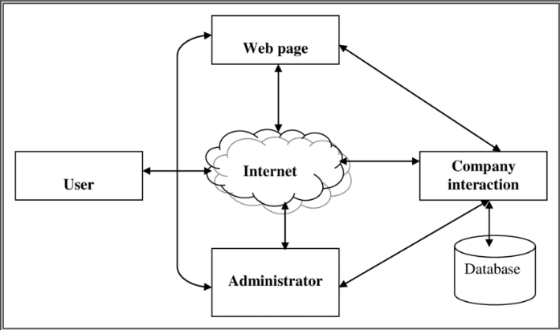
Methodology used

Slide 8
Design methodology
Scoping and agile methodology
Conceptual design and research
Development of methodology
Implementation of methodology
Revision of methodology

Slide 9
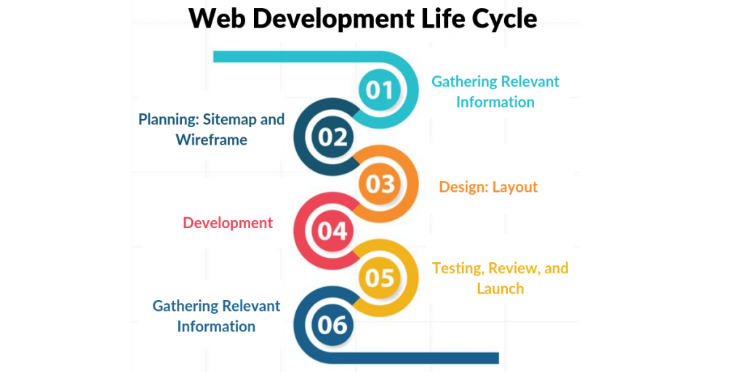

Slide 10
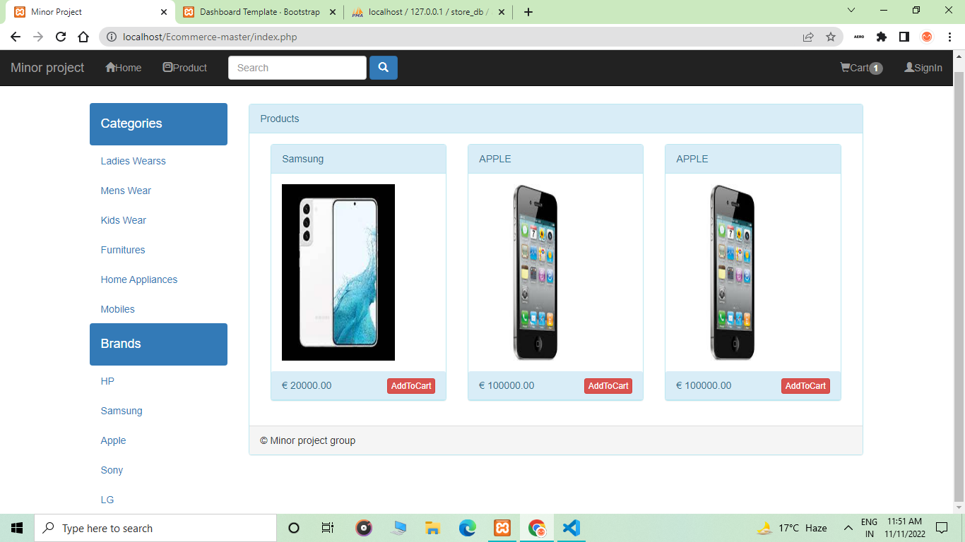
Results and Outputs

Slide 11
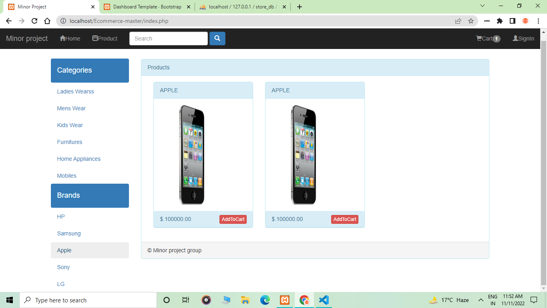

Slide 12
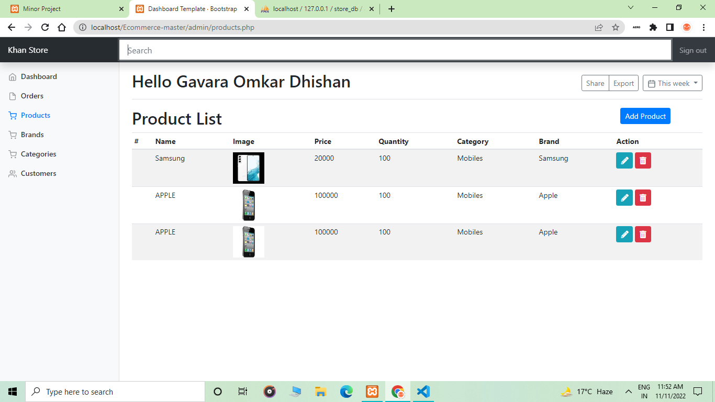

Slide 13
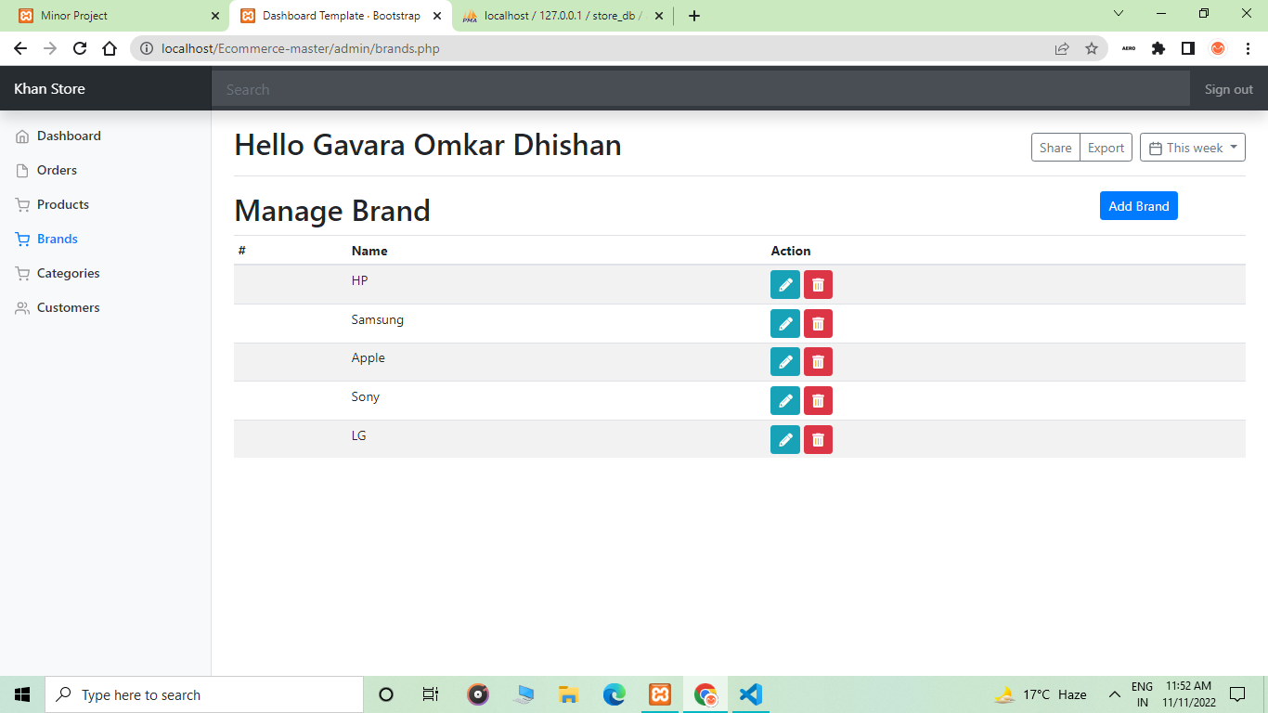

Slide 14
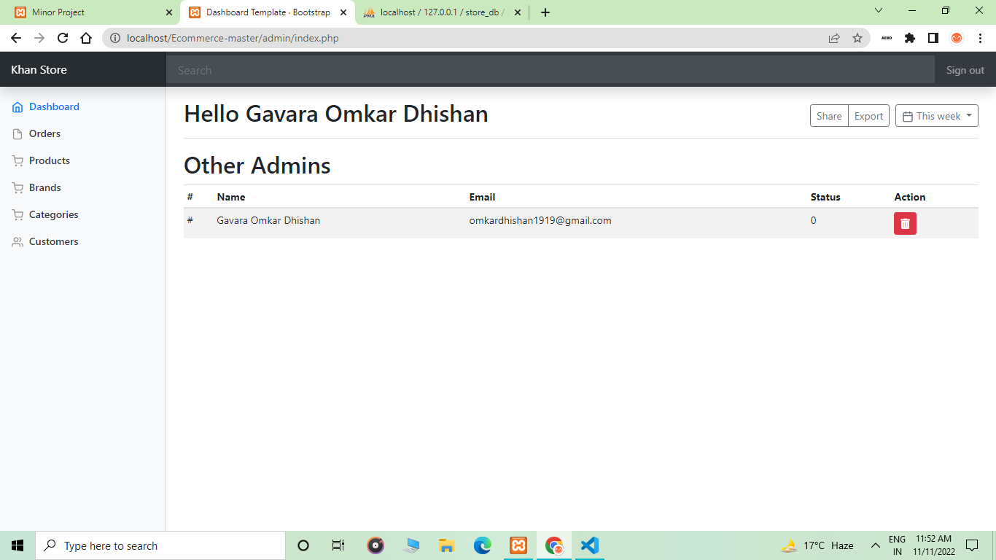

Slide 15
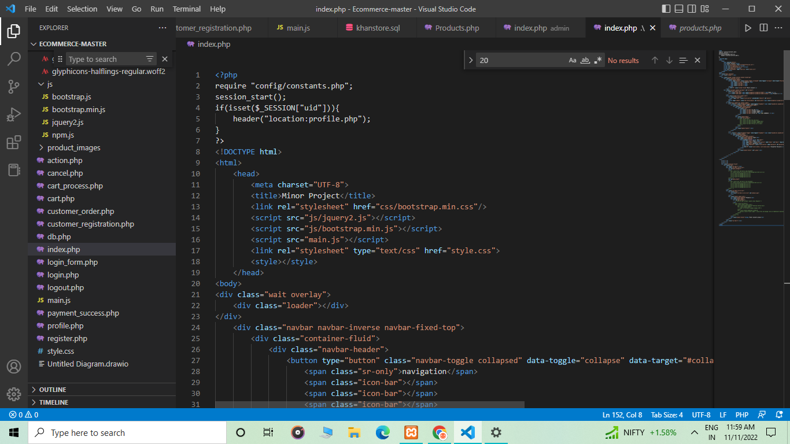

Slide 16
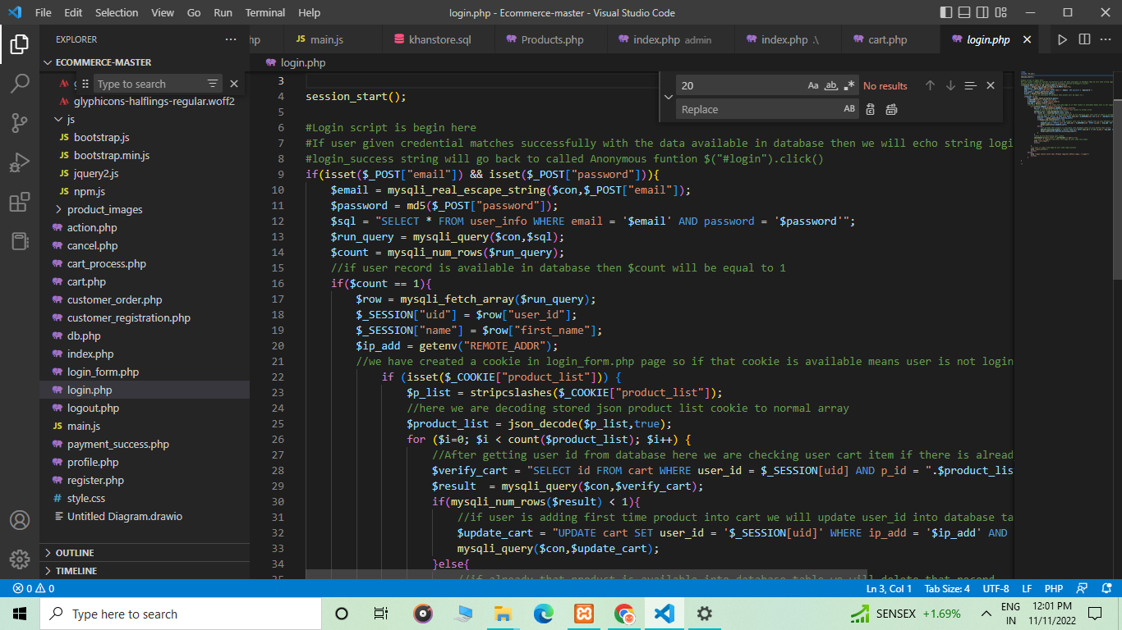

Slide 17
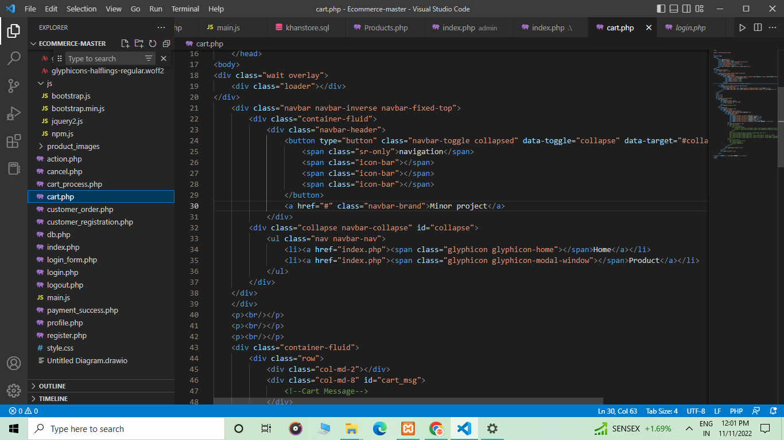

Slide 18
Conclusion
E-commerce (electronic commerce) is the buying and selling of goods and services, or the transmitting of funds or data, over an electronic network, primarily the internet
Hence, our project E-commerce website provides the design and working that how a E-commerce website will work.

Slide 19
Future Scope
The world is constantly updating in the terms of Information
Technology. Due to this people are showing less interest in the
outdoor shipping and we can also see that the percentage of
Digital Buyers is increased to 47.3%. So making this the way
there are many E-commerce website coming day by day in the
market . So, this ecommerce website have a large scope in the
future

Slide 20
References
http://www.ecom.cmu.edu/resources/elibrary/eclgloss.shtml
http://ecommerce.internet.com/resources/library/paysolutions
http://www2.uta.edu/ecomm/resources/glossaryComplete.asp.
http://www.oregoninnovation.org/pressroom/glossary.a-c.html
http://cyber.law.harvard.edu/ecommerce/austin.ppt
http://www.haleanddorr.com/internet_law/Utah_Lighthouse/prelim.html.

Slide 21
http://caselaw.lp.findlaw.com/scripts/ts_search.pl?title=17&sec=107
http://caselaw.lp.findlaw.com/scripts/getcase.pl?navby=case&court=us&vol=464&page=417
http://cyber.law.harvard.edu/property00/metatags/main.html
Ayo, Charles K. (2006). “The Prospects of e-Commerce Implementation in Nigeria, Journal of Internet
Banking and Commerce”, Vol. 11, No.3, pp. 68-75
https://www.youtube.com/watch?v=P8YuWEkTeuE
https://www.youtube.com/watch?v=NsqLLPCZpUo
https://www.youtube.com/watch?v=QsAVoLPqkRQ

